Slide 1


Slide 2
ABOUT DABUR
Our Vision
Dedicated to the Health & Well-Being of Every Household
Our Mission
Contemporise Ayurveda and make it relevant for the new generation

Slide 3
Market share of Dabur in FMCG:
Company’s Name Market Share (%)
ITC 14%
Hindustan Unilever (HUL) 12%
Marico 5%
Parle Agro 8%
Nestlé 3%
Britannia 3%
Dabur 2%
Godrej Group 2%
Procter & Gamble Co. 10.74 %
Colgate-Palmolive 7.06 %
Johnson and Johnson 7.12%

Slide 4
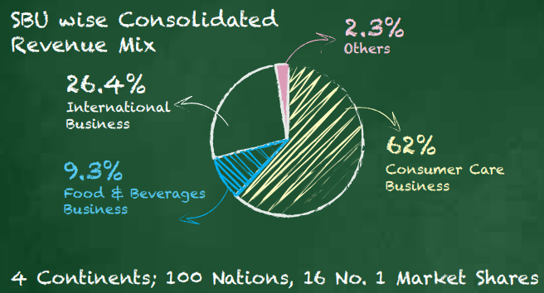
Dabur’s Revenue Share

Slide 5
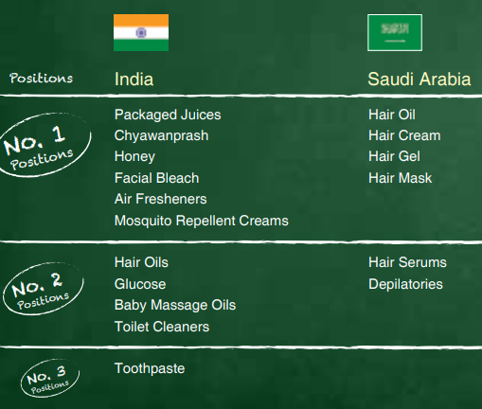
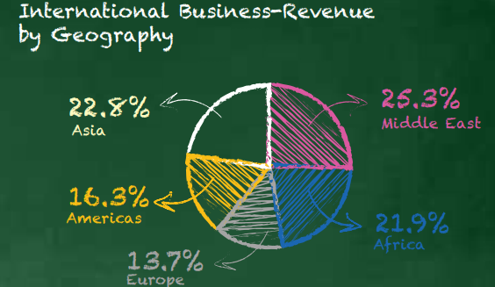
International Business/ Revenue Distribution

Slide 6
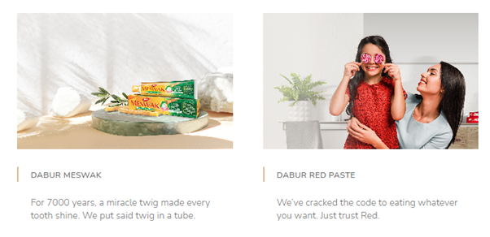
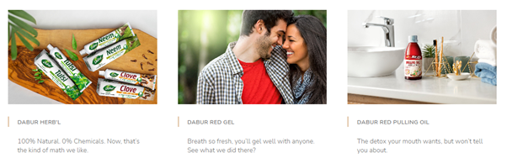
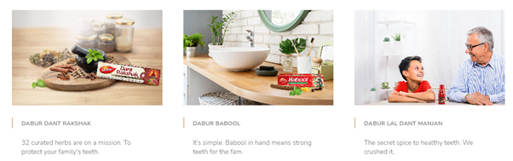
DABUR- ORAL CARE

Slide 7
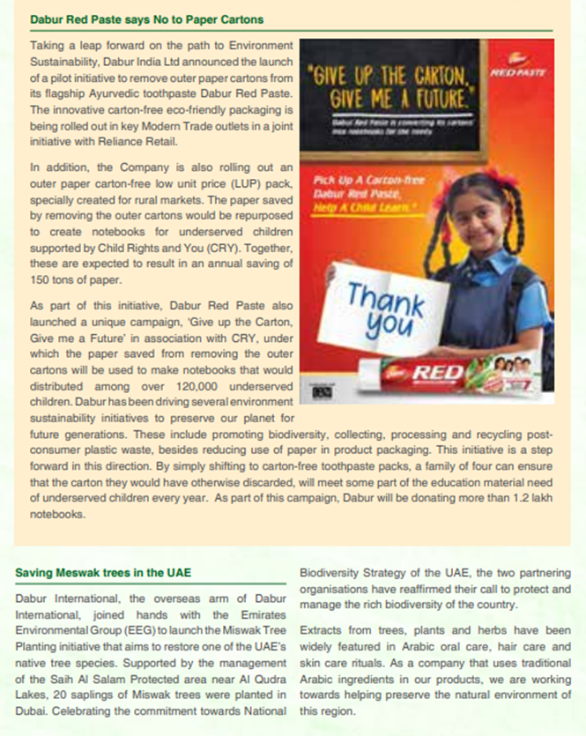
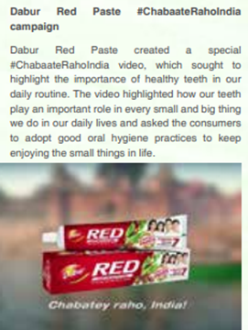
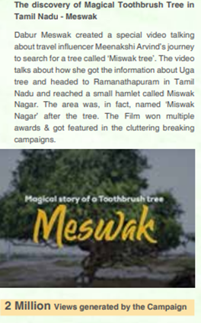
Dabur- oral Care Promotions

Slide 8
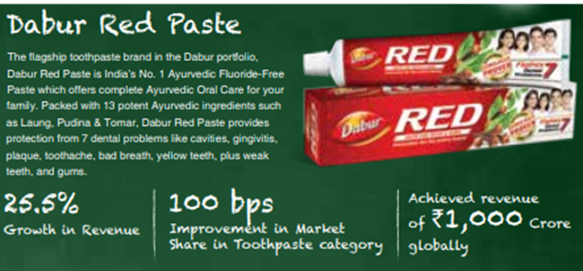

Slide 9
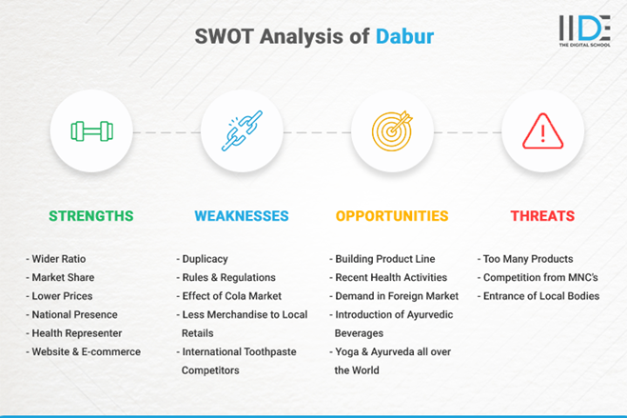

Slide 10
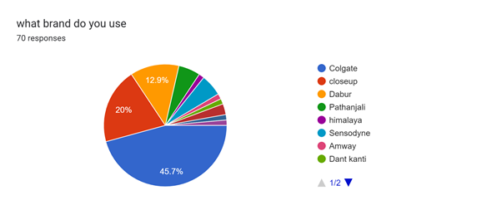
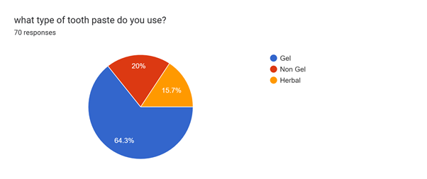
Survey Results

Slide 11
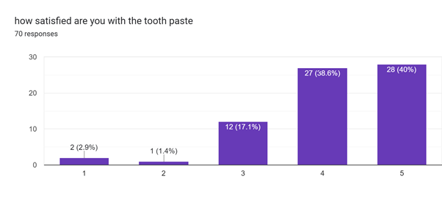
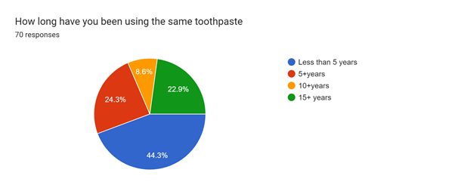
Strength of the product

Slide 12
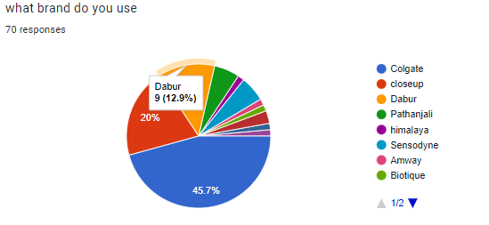
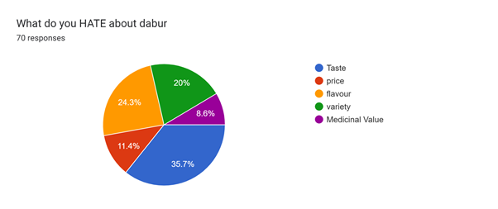
Dabur in the minds of Youth

Slide 13
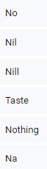
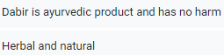

Slide 14
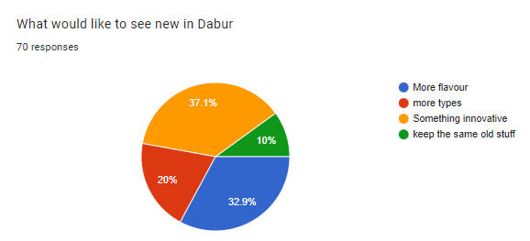
What does the youth want?

Slide 15
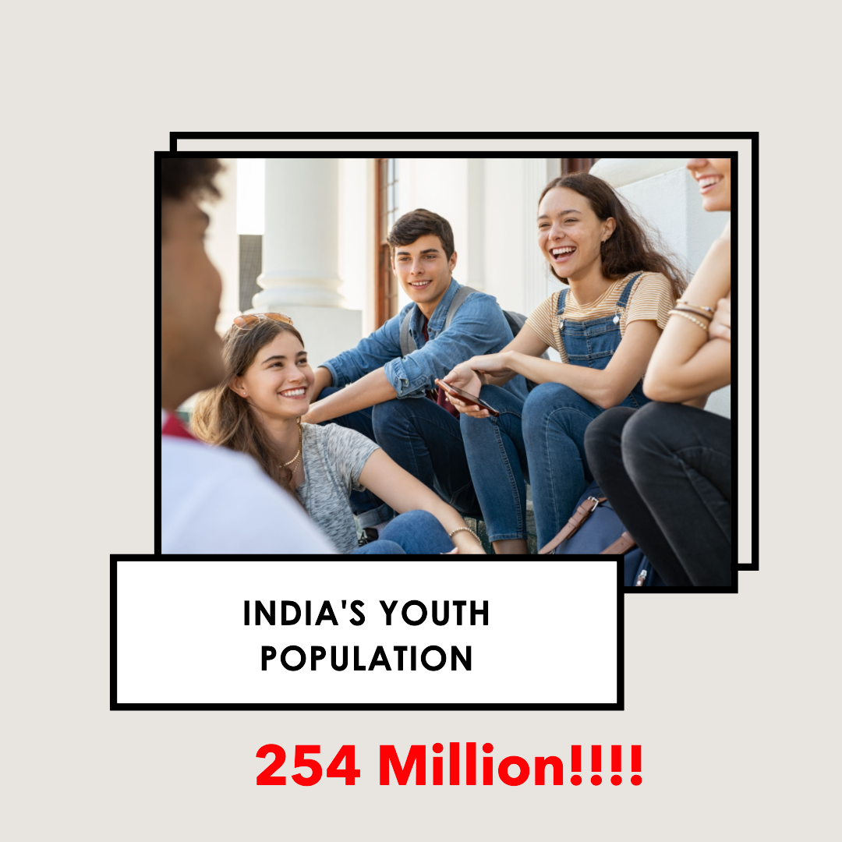
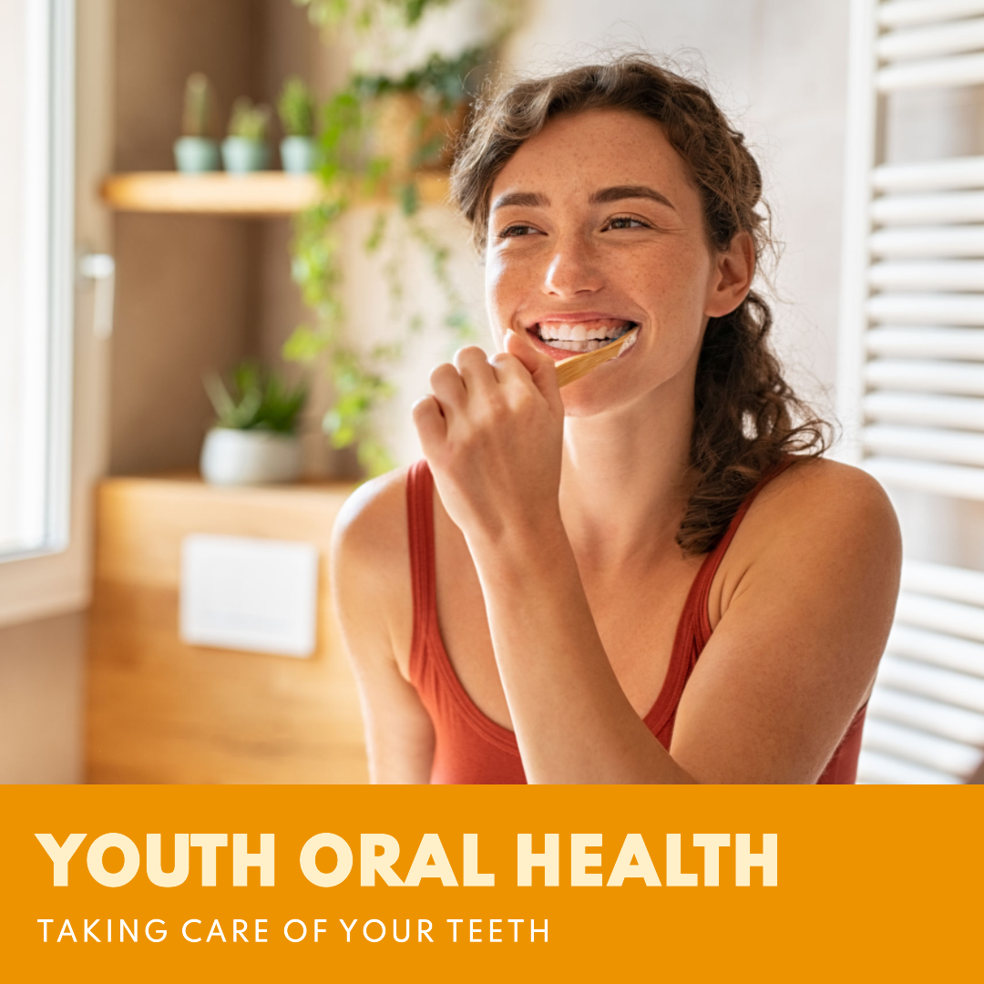
What can Dabur do?- Youth

Slide 16
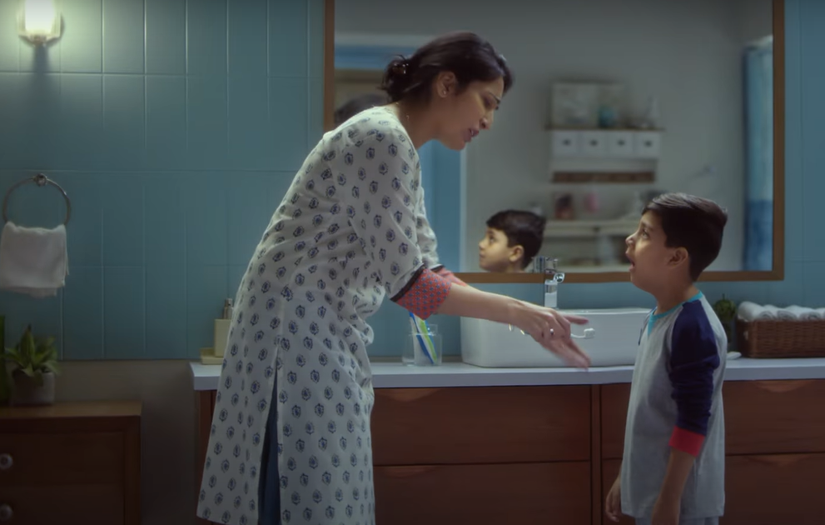
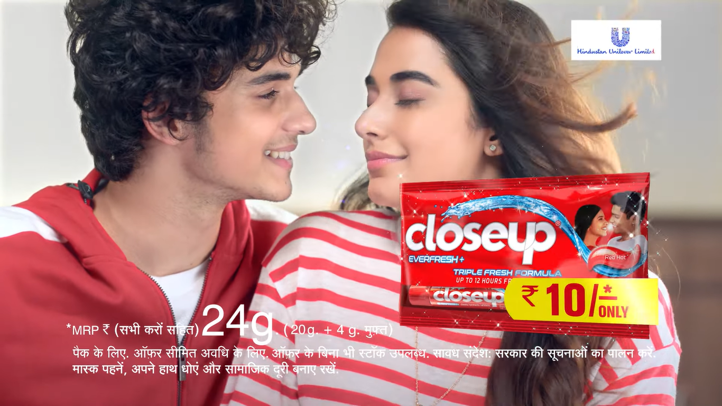
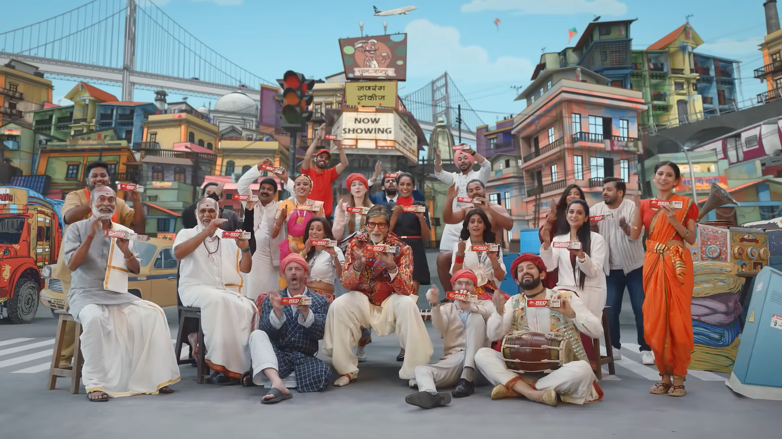

Slide 17
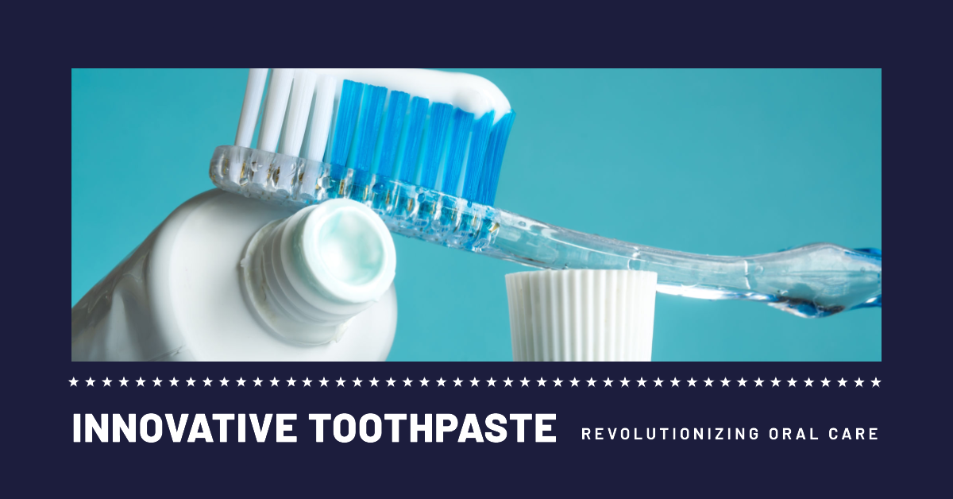
Innovation

Slide 18
What will these solve
1. Increasing Competition
2. Low Awareness
3. Change in Consumer Preference
4. Low sales / Low distribution channels

Slide 19


